Slide 1
Electric Shock
Dr Jackson Kwizera Ndekezi
Anesthesiologist
Critical care medicine fellow

Slide 2
What Is An Electric Shock
-An electric shock occurs when someone comes in contact with an electric energy source.
-When an electric energy then flows through a portion of the body causing a shock.

Slide 3
How Can I Get An Electric Shock
By poorly insulated wires or ungrounded electrical equipments
-By using electrical equipment while in contact with water
-By being struck by lightning

Slide 4
Different types of electric shocks

Slide 5
entertainment
Shocking pens
Shocking gum
joy buzzer
And most machines in in amusement parks

Slide 6
Law enforcement and personal defence
Taser
Electric fences

Slide 7
Torture
The Parrilla

Slide 8
Capital punishment
electric chair

Slide 9
What Happens When You Get An Electric Shock
-An electric shock can have no injury at all
-Burns (which are the most common)
-Devasting damage
-Death

Slide 10
Many Factors Determine Which Type Of Injury Occurs
-The type of current (ac or dc)
-The amount of current
-The pathway the electricity takes through the body.

Slide 11
After A Low Voltage Shock a Person Should Call The Doctor If
-If burn are not healing well
-Burns with increasing redness soreness,or damage
-Any electric shock in a women who is pregnant

Slide 12
following a low voltage shock a person should go to the emergnency depArtment if
-Any noticeable burns on skin
-Unconsciousness
-Numbness, tingling, paralysis, vision, hearing, or speech promblems
-An electric shock in a women more than 20 weeks pregnant

Slide 13
A person shocked by high voltage(500 volts
or more) shoultd be evaluated in the emergency department.

Slide 14
what will be done when you go to Athe emergincy room
-Electrocardiogram to check the heart
complete blood count
-Urine test for muscle enzymes
-X-Ray
-CAT scan

Slide 15
electric shock prevention for children younger then 12
-Inspect power cords and extension cords do not allow children to play with any electric cords
-Limit the use of extention cords and be sure that the cords is rated for the current
-Use the outlet covers to protect infants
-Update old ungrounded electrical outlets to grounded systems
-Replace outlets near and water with fused outlets

Slide 16
electric shock prevention for children older than 12
-Explain to an adolescent children that they should
not climb on power tower,play near transformer systems and electrified train rails or other electrical systems.

Slide 17
electric shock prevention for among adults
-Use common sense can help reduce electrical
injury.people who work with electricity should always check that the power is off before
working on electrical systems
-Avoid use of any electrical device near water
be careful of standing in water or when working with electricity

Slide 18
Electric Shock revention
-Use caution when outdoor during a thunderstorm contaning lightning
protect yourself from lighting strikes by seeking
shelter in a sturdy building
crouch low and away from trees and metal objects if caught outdoors

Slide 19

Heat Illnesses (Hyperthermia)
Heat rash
Sunburn
Heat cramps
Heat exhaustion
Heat stroke
Severity
American Meteorological Society Central North Carolina Chapter
April 21, 2005

Slide 20
Heat stroke
Dr Jackson KWIZERA NDAKEKZI
Anesthesiologist
University of Rwanda

Slide 21
DEFINITION
A core temperature ≥40°C accompanied by CNS dysfunction in patients with environmental heat exposure. This condition represents a failure of the body's ability to maintain thermoregulatory homeostasis.

Slide 22
Classification
Classic (nonexertional) heat stroke : more common in younger children who are unable to escape from hot environments and those with underlying chronic medical conditions that impair thermoregulation.
Exertional heat stroke : generally occurs in healthy individuals who engage in heavy exercise during periods of high temperature and humidity. Typical patients are athletes and military recruits in basic training.

Slide 23
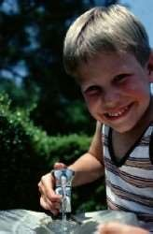
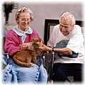
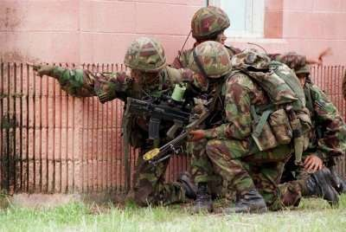


Who’s at risk?
Elderly
Children
Outdoor workers (construction, roofers, migrant workers)
Military

Slide 24
CLINICAL FEATURES
The diagnostic criteria are elevated core temperature (≥40°C) and (CNS) abnormalities following environmental heat exposure.
Children with elevated body temperature and CNS abnormalities should be treated as victims of heat stroke.

Slide 25
CNS Manifestations
CNS symptoms can be manifested as
Impaired judgment
inappropriate behavior
Children commonly present with more significant neurologic symptoms such as
seizures
delirium
hallucinations
ataxia
coma

Slide 26
Other Clinical Manifestations
Tachycardia
Tachypnea
The skin may be flushed and warm or diaphoretic.
Vomiting and diarrhea are also common.
Those patients with coagulopathy may demonstrate
purpura,
hemoptysis,
hematemesis,
melena,
hematochezia.

Slide 27
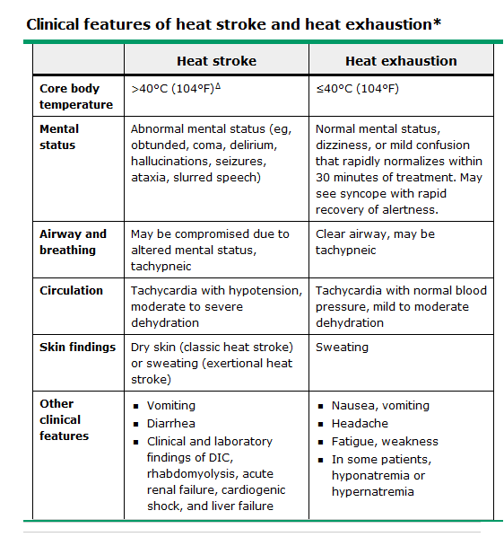

Slide 28
DIAGNOSTIC EVALUATION
Clinical assessment:
The diagnosis of heat stroke is based upon a careful history and physical examination.

Slide 29
Core temperature measurement
Should be determined in all patients and continuously monitored.
Rectal temperature is the most commonly obtained core temperature measurement, although esophageal, central venous, pulmonary artery, or bladder probe temperature are potential alternatives.
Oral, axillary, or tympanic membrane temperatures are unreliable in treating heat illness.

Slide 30
Laboratory findings
Rapid blood glucose to identify hypoglycemia
Blood gas (venous or arterial) to evaluate for the presence and
severity of metabolic acidosis
CBC,(PT), (PTT), INR and Serum electrolytes .
Liver enzymes to assess for liver injury
Urea and creatinine to identify prerenal azotemia or renal failure resulting from myoglobinuria
Serum (CK), ionized or total calcium, and phosphate to detect rhabdomyolysis , hypocalcemia and hyperphosphatemia
Urine rapid dipstick and urinalysis to diagnose myoglobinuria
Toxicologic screening for drugs of abuse or prescribed medications

Slide 31
Chest radiograph:
Helps identify pulmonary edema and is useful in patients for whom pulmonary aspiration is a concern.
Electrocardiogram:
Should be obtained in patients with electrolyte abnormalities (eg, hyperkalemia, hypokalemia, hypocalcemia) and/or rhabdomyolysis.
Computed tomography:
CT-Brain should be obtained if a child has persistently altered mental status despite cooling or shows signs of increased intracranial pressure suggestive of cerebral edema or intracranial hemorrhage.

Slide 32
DIFFERENTIAL DIAGNOSIS
Sepsis
Central nervous system conditions
Status epilepticus
Toxic overdose
Serotonin syndrome
Hemorrhagic shock and encephalopathy syndrome
Neuroleptic malignant syndrome
Thyroid storm
Malignant hyperthermia

Slide 33
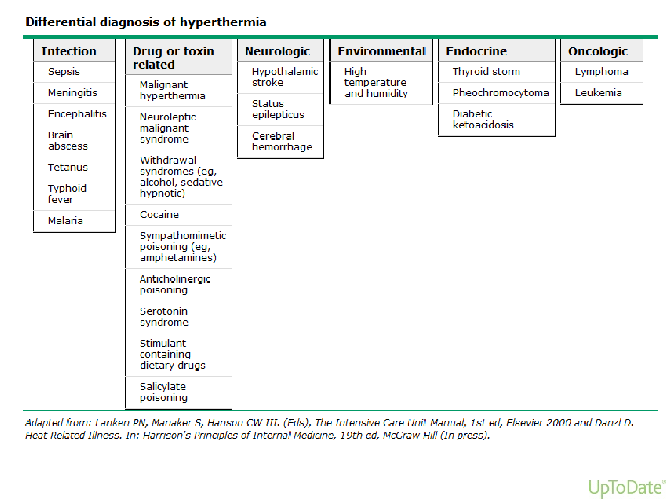

Slide 34
PREHOSPITAL CARE
Cooling might have occurred prior to the arrival of the hospital.
Removal from the source of heat stress and rapid initiation of cooling, as the risk of morbidity and mortality for patients with heat-related illness is associated with the duration of hyperthermia.

Slide 35
Patients with heat stroke should be treated with either ice water immersion or evaporative external cooling in the field.
Pre-hospital cooling measure should be initiated prior to / or simultaneously with activation of emergency medical services.

Slide 36
Evaporative cooling may be accomplished in the field by spraying patients with water or saline and fanning these patients, either manually or with ambulance fans or air- conditioners. Application of ice packs to the neck, axillae, and groin.
The institution of pre-hospital cooling should not delay timely transportation to definitive care.

Slide 37
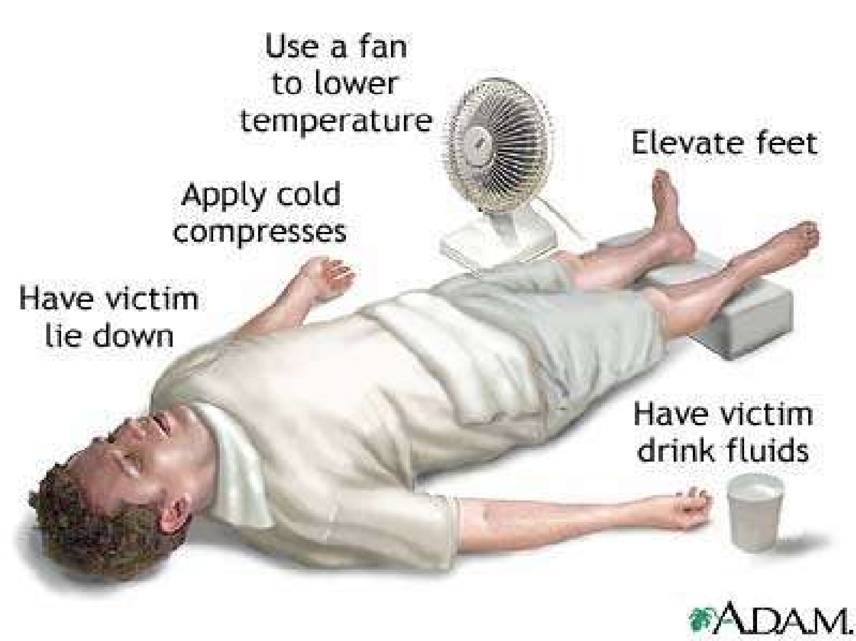
21

Slide 38
HOSPITAL MANAGEMENT
Stabilization: In addition to the careful assessment and support of airway, breathing, and circulation, the clinician should anticipate and aggressively manage hyperthermia, dehydration, rhabdomyolysis, DIC, high output cardiac insufficiency, renal and hepatic failure.
Altered mental status typically resolves once oxygenation, adequate tissue perfusion, and normothermia are achieved.
Seizures should be treated with benzodiazepines (lorazepam 0.1mg/kg,IV)

Slide 39
Rapid cooling
Evaporative cooling:
is achieved by spraying patients with tepid water (to minimize shivering) while fanning with high-flow fans to maximize air circulation. Cooling rates approaching 0.15ºC per minute have been achieved in adults. Alternatively, the patient may be placed on a cooling blanket. If tolerated, selective application of ice packs to the neck, axillae, and groin during evaporative cooling may be of additional benefit.

Slide 40
Rapid cooling
Cold water immersion:
Cold water immersion is another adjunctive cooling modality when evaporative cooling with or without selective ice application is not possible.

Slide 41
Internal cooling
The most effective method of lowering the core body temperature quickly is the use of cardiopulmonary bypass; however, this highly specialized intervention is not rapidly available at most institutions.
Newer, less invasive devices such as intravascular cooling catheters have been utilized to rapidly induce therapeutic hypothermia .

Slide 42
Gastric, rectal, and/or bladder lavage with cold isotonic fluids (eg, normal saline that has been iced) have been proposed as additional means of invasive cooling. However, it is not clear that these methods are any more effective than evaporative cooling or cold water immersion alone. Thus, these methods are not routinely employed.

Slide 43
Duration of cooling
Decreases in core body temperature as measured by rectal temperature generally lag behind the actual drop in core temperature at the hypothalamus. For this reason, cooling measures are generally stopped in pediatric heat stroke victims once the core temperature reaches approximately 38ºC to prevent overshoot hypothermia.

Slide 44
Pharmacologic therapy
Medications have a limited role in the management of heat stroke. However, pharmacologic measures taken to prevent shivering.
We suggest that patients with heat stroke receive benzodiazepines (eg, midazolam 0.05 to 0.1 mg/kg iv ) to prevent shivering during cooling measures.
Although antipsychotic agents (chlorpromazine) have been used in adults to prevent shivering,it may exacerbate hypotension in heat stroke victims. They also have a greater propensity to cause dystonia in children. Thus, they should be avoided.

Slide 45
Dantrolene Although initial evidence suggested that dantrolene shortened cooling times in adults with heat stroke, additional small trials have not identified a consistent benefit. Thus, dantrolene is not routinely used.
Antipyretic medications (acetaminophen, ibuprofen) are ineffective for the treatment of hyperthermia in heat stroke victims and should not be used because they may exacerbate liver injury (acetaminophen) or compound coagulation disorders (nonsteroidal antiinflammatory agents, ibuprofen).

Slide 46
Treatment of end-organ dysfunction
After stabilization and rapid cooling, the victim with heat stroke remains at high risk for multiple organ failure, metabolic abnormalities, and disorders of coagulation.

Slide 47
Rhabdomyolysis with hyperkalemia, hypocalcemia, and hyperphosphatemia
DIC
Acute kidney injury
Hyponatremic dehydration
Cardiogenic shock with low systemic vascular resistance
Cardiogenic and noncardiogenic pulmonary (ARDS)
Liver failure : Treatment is supportive. Rarely, liver transplantation has been necessary in teenagers with heat stroke-associated liver failure.
Cerebral edema

Slide 48
Complications
Respiratory dysfunction:
– Tracheal intubation and mechanical ventilation are often necessary. In a review of 28 patients admitted with heat stroke, 24 (86 percent) developed respiratory failure with most requiring mechanical ventilation.

Slide 49
Arrhythmia and cardiac dysfunction :
Potential cardiac complications include acute decompensated heart failure and myocardial injury .ECG abnormalities include sinus tachycardia , conduction abnormalities, prolonged QT interval, transient Brugada pattern, and nonspecific ST-T changes. Rapid cooling is essential; cardiac dysfunction and tachyarrhythmias generally resolve with cooling.

Slide 50
Hypotension :
Hypotension associated with heat stroke results from peripheral vasodilation, cardiac dysfunction, and volume depletion. Treatment consists primarily of discrete intravenous (IV) boluses of isotonic crystalloid (eg, isotonic saline 250 to 500 mL). Given the risk of pulmonary edema, excessive fluid administration should be avoided.

Slide 51
Seizures:
Seizures are common. Initial treatment consists of short- acting benzodiazepines, while cooling measures are initiated. Midazolam 0.1 to 0.2 mg/kg IV, to a maximum dose of 4 mg, has an onset of action one to five minutes and duration of action of 1 to 6 hours. Lorazepam 0.1 mg/kg IV, to maximum dose of 4 mg, is a second-line option, as the duration of action may be prolonged from 12 to 24 hours. Barbiturates should be avoided. Rapid cooling is essential to treatment.

Slide 52
Acute kidney injury & Rhabdomyolysis:
Renal function studies and serum electrolyte should be followed closely over the first few days of illness; renal replacement therapy may be needed.

Slide 53
Hepatic injury:
Generally self-limited but in some cases may progress to acute liver failure, with a subset of patients requiring liver transplantation.

Slide 54
DIC
can develop during the first 3 days of illness and coagulation studies should be monitored during this period. Replacement of clotting factors with FFP and platelets may be necessary.

Slide 55
OUTCOMES
Morbidity or mortality are directly related to duration and degree of hyperthermia.ition, prognosis depends on the patient population and type of heat stroke.

Slide 56
Mortality
Mortality of up to 63 % has been reported in elderly adults with classic heat stroke. In contrast, mortality is much lower (1 to 15 %) in adolescents and young adults with exertional heat stroke. Additional poor prognostic indicators for mortality include the height of the initial core body temperature and the number of organ systems affected during the course of treatment.

Slide 57
Neurologic abnormalities
Permanent neurologic damage is more commonly seen in patients with core temperatures >42ºC (107.6ºF) and consist of
spasticity,
ataxia,
dysarthria,
poor coordination,
impaired memory, and
behavioral changes.
Patients recovering from rapidly treated exertional or classic heat stroke with core body temperatures below this level may manifest some of these neurologic findings but typically recover fully.

Slide 58
Preventing heat-related illness
Dress for the heat : Wear lightweight, light-coloured clothing. It is also a good idea to wear hats or to use an umbrella.
Drink water : Carry water or juice with you and drink continuously even if you do not feel thirsty. Avoid alcohol and caffeine, which dehydrate the body.
Avoid foods that are high in protein, which increase metabolic heat.
Stay indoors when possible.
Take regular breaks when engaged in physical activity on warm days.
Take time out to find a cool place.
42

Slide 59
Take Home Message
Children with elevated body temperature and CNS
abnormalities should be treated as victims of heat stroke.
Rectal temperature is the most commonly obtained core temperature measurement.
Morbidity or mortality are directly related to duration and
degree of hyperthermia.
The institution of prehospital cooling should not delay timely transportation to definitive care.
The most effective method of lowering the core body temperature quickly is the use of cardiopulmonary bypass.

Slide 60
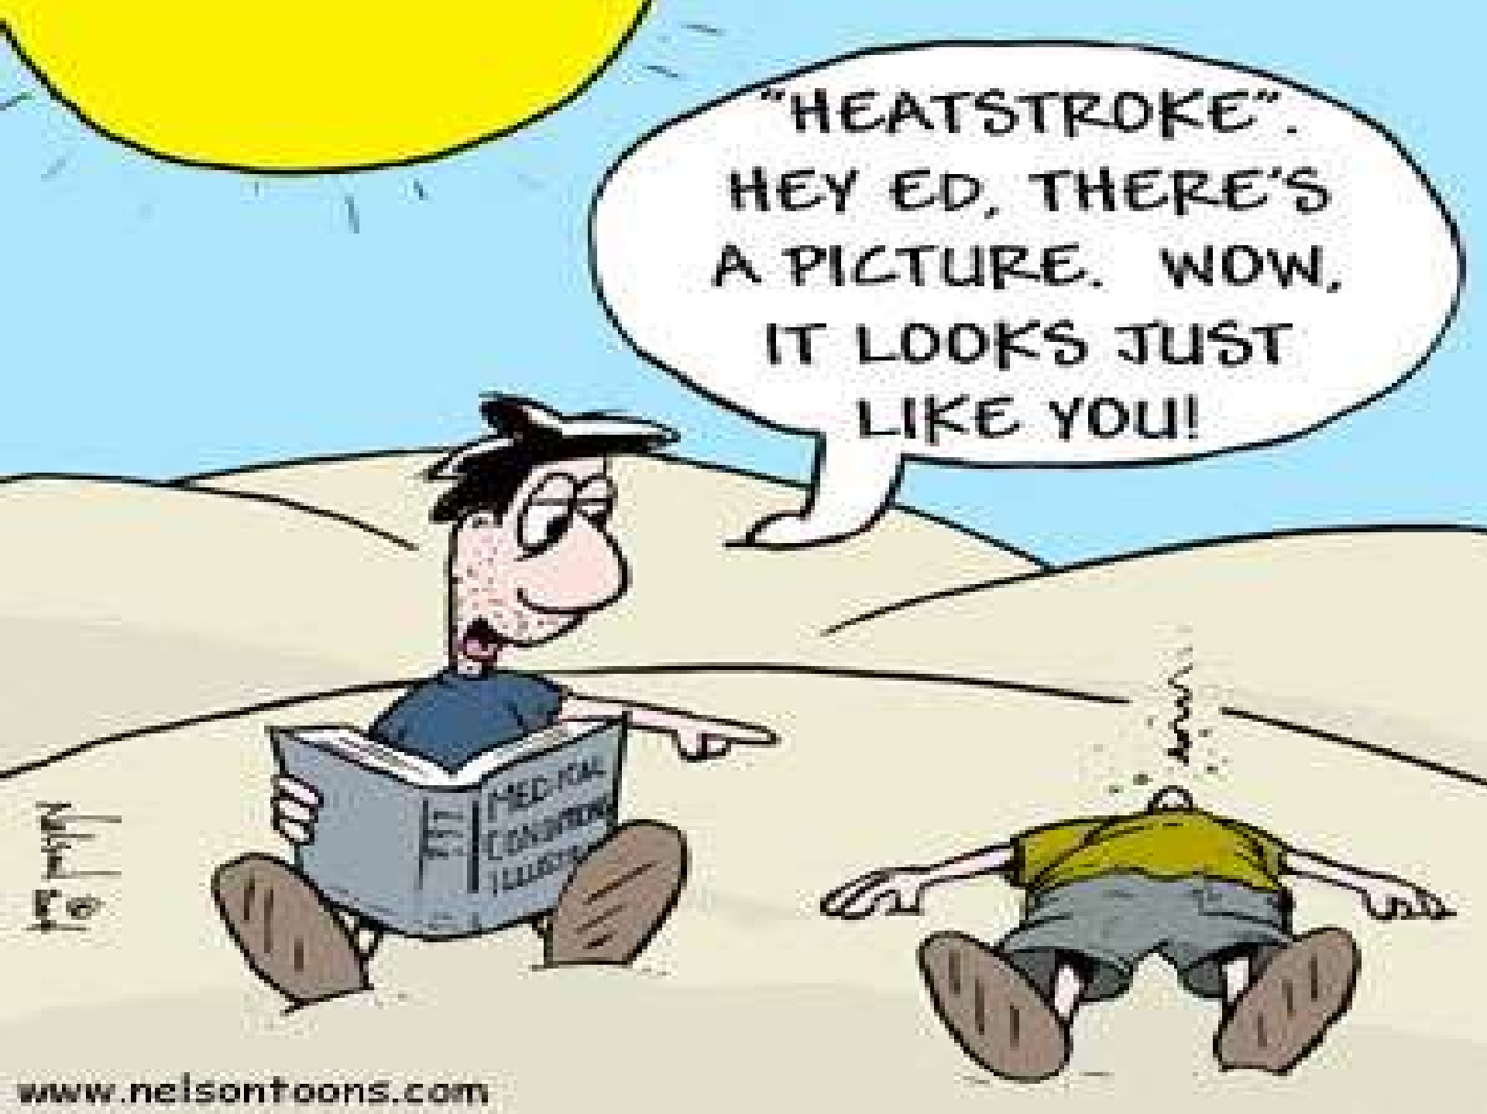

Slide 61
Take Home Message
Children with elevated body temperature and CNS
abnormalities should be treated as victims of heat stroke.
Rectal temperature is the most commonly obtained core temperature measurement.
Morbidity or mortality are directly related to duration and
degree of hyperthermia.
The institution of prehospital cooling should not delay timely transportation to definitive care.
The most effective method of lowering the core body temperature quickly is the use of cardiopulmonary bypass.

Slide 62
Preventing heat-related illness
Dress for the heat : Wear lightweight, light-coloured clothing. It is also a good idea to wear hats or to use an umbrella.
Drink water : Carry water or juice with you and drink continuously even if you do not feel thirsty. Avoid alcohol and caffeine, which dehydrate the body.
Avoid foods that are high in protein, which increase metabolic heat.
Stay indoors when possible.
Take regular breaks when engaged in physical activity on warm days.
Take time out to find a cool place.
42

Slide 63
Porphyrias
Gandham.Rajeev

Slide 64
Porphyrias
Porphyrias are the metabolic disorders of heme synthesis, characterized by the increased excretion of porphyrins or porphyrin precurcors.
Porphyrias are either inherited or acquired.
The most common acquired form of porphyria is due to lead poisoning.

Slide 65
Classification of porphyrias
Porphyrias
Erythropoietic
Hepatic
Erythropoietic (bone marrow):
Enzyme deficiency occurs in the erythrocytes.
Hepatic:
Enzyme defect lies in the liver.

Slide 66


Different types of porphyrias
Type of porphyria Enzyme defect Characteristics
HEPATIC
Uroporphyrinogen I synthase
Acute intermittent porphyria
Abdominal pain, neuropsychiatric symptoms
Porphyria cutanea tarda
Uroporphyrinogen decarboxylase
Photosensitivity
Hereditary
coproporphyria
Coproporphyrinogen
oxidase
Abdominal pain, Photosensitivity , neuropsychiatric symptoms
Variegate porphyria
Protoporphyrinogen oxidase
Abdominal pain, Photosensitivity , neuropsychiatric symptoms
ERYTHROPOIETIC PORPHYRIA
Congenital erythropoietic porphyria
Uroporphyrinogen III cosynthase
Photosensitivity , increased hemolysis
Protoporphyria
Ferrochelatase
Photosensitivity

Slide 67
Hepatic porphyria
Acute intermittent porphyria:
Enzyme defect: Uroporphyrinogen I synthase
Characteristic features:
Increased excretion of porphobilinogen & γ-ALA.
Urine gets darkened on exposure to air due to conversion of porphobilinogen to porphobilin &
porphyrin.
It usually expressed after puberty.

Slide 68
Symptoms
Abdominal pain, vomiting & cardiovascular abnormalities.
Neuropsychiatric distrubances- due reduced activity of tryptophan pyrrolase (caused by depleted heme levels) resulting in the accumulation of tryptophan & 5- hydroxytryptamine.

Slide 69
Symptoms are more severe after administration of drugs (e.g. barbiturates)
It induce the synthesis of cytochrome P450.
This is due to the increased activity of ALA synthase causing accumulation of PBG & ALA.
These patients are not photosensitive.
It is treated by administration of hematin, it inhibits ALA sytnthase & accumulation of porphobilinogen.

Slide 70
Porphyria cutanea tarda
This is also known as cutaneous hepatic porphyria & is the most common porphyria.
It associated with liver damage caused by alcohol overconsumption or iron overload.
Enzyme deficiency:
Uroporphyrinogen decarboxylase.

Slide 71
Characteristic features
lncreased excretion of uroporphyrins (l & lll) & rarely porphobilinogen.
Cutaneous photosensitivity is the most important clinical manifestation of these patients.
Skin fragility, scarring, sclerodermoid skin changes.
Liver exhibits fluorescence due to high
concentration of accumulated porphyrins.

Slide 72
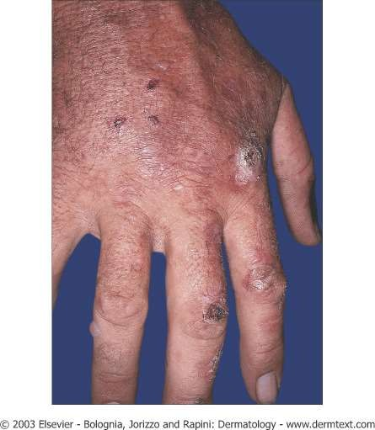
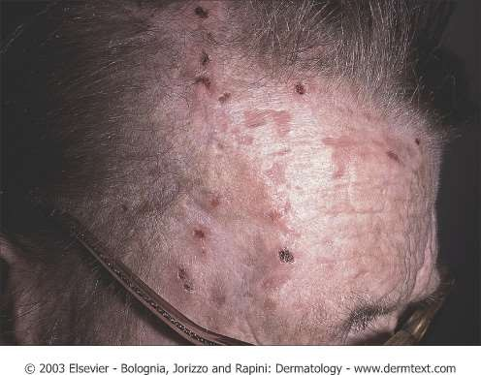
Porphyria cutanea tarda

Slide 73
Hereditary coproporphyria
Enzyme defect:
Coproporphyrinogen oxidase.
Coproporphyrinogen lll & other intermediates (ALA and PBC) of heme synthesis prior to the blockade are excreted in urine & feces.
The patients are photosensitive.

Slide 74
Symptoms
Symptoms are similar to acute intermittent porphyria
Abdominal pain, vomiting & cardiovascular abnormalities.

Slide 75
Neuropsychiatric distrubances- due reduced activity of tryptophan pyrrolase (caused by depleted heme levels) resulting in the accumulation of tryptophan & 5- hydroxytryptamine.
It is treated by administration of hematin, it inhibits ALA stnthase & accumulation of porphobilinogen.

Slide 76
Variegate porphyria
Enzyme defect: Protoporphyrinogen oxidase
Due to this blockade, protoporphyrin lX required for the ultimate synthesis of heme is not produced.
Almost all the intermediates (porphobilinogen, coproporphyrin, uroporphyrin, protoporphyrin etc.) of heme synthesis accumulate in the body & are excreted in urine and feces.
The urine of these patients is coloured & they exhibit photosensitivity

Slide 77
Erythropoietic porphyria
Congenital erythropoietic porphyria:
Enzyme defect:
Uroporphyrinogen III cosynthase.
Also caused by an imbalance between the activities of uroporphyrinogen I synthase and uroporphyrinogen lll cosynthase

Slide 78
Characteristic features
It is a rare congenital disorder.
Mostly contained in erythropoietic tissues (bone)
Individuals excrete uroporphyrinogen I & coproporphyrinogen I which oxidize respectively to uroporphyrin I & coproporphyrin I.

Slide 79
The patients are photosensitive (itching & burning of skin when exposed to light).
Skin pain or burning in sunlight
Erythema, swelling.
Erosions in light exposed areas-mainly in face & hands.
Scarring - shallow circular or linear.
Waxy thickening of the skin.
Increased hemolysis.

Slide 80
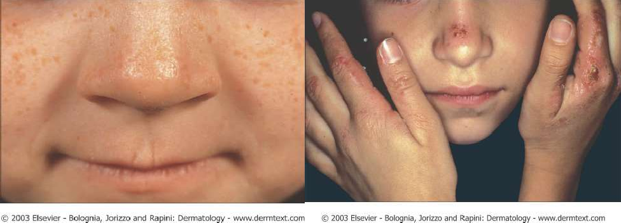
Erythropoietic porphyria

Slide 81
Protoporphyria
Also known as erythropoietic protoporphyria.
Enzyme defect:
Ferrochelatase.
Protoporphyrin IX accumulates in tissues & is excreted into urine & feces.
Reticulocytes (young RBC) & skin biopsy exhibit red flourorescence.

Slide 82
Acquired or toxic porphyria
It occur due to toxicity of several compounds.
Exposure of the body to heavy metals (e.g. lead), toxic compounds (hexachlorobenzene) and drugs (e.g. griseofulvin) inhibits many enzymes in heme synthesis.
These includes ALA dehydratase, uroporphyrin I synthase & ferrochelatase.

Slide 83
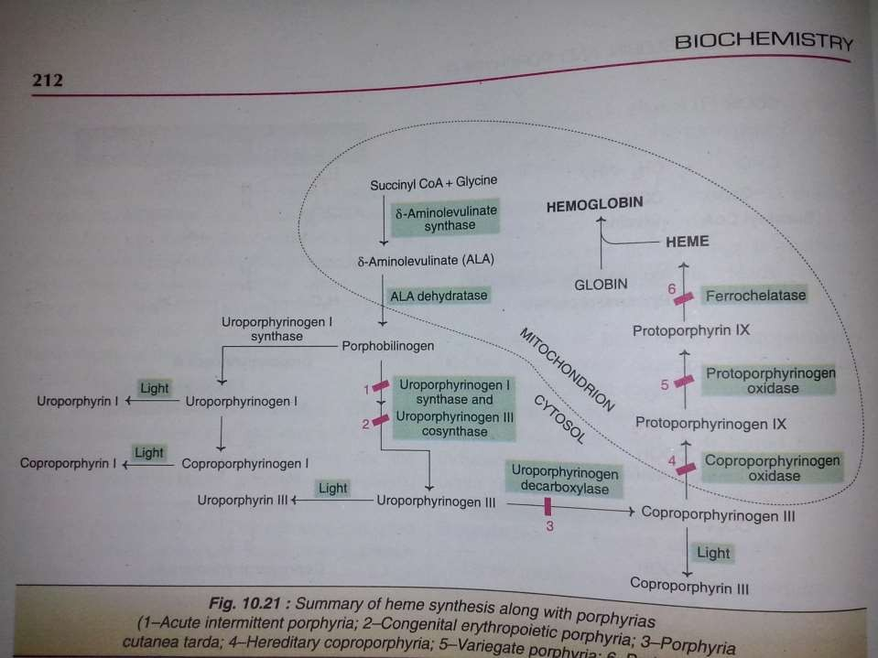

Slide 84


Slide 85
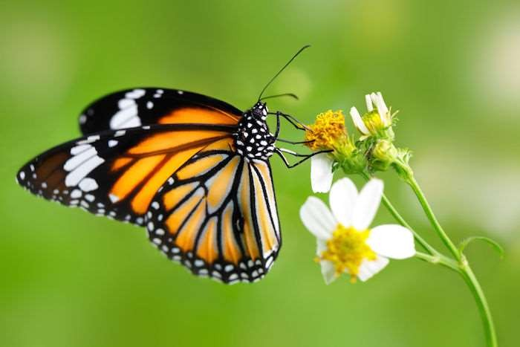
A Presentation
On
“Poisoning”

Slide 86

PRESENTATION ON POISONING
Presented by-
Asraful Islam Rayhan
Dept. of Pharmacy JESSORE UNIVERSITY OF SCIENCE & TECHNOLOGY

Slide 87
Outline…
Poisoning
Poison
Medicinal Poisoning
Environmental Poisoning
Factors Affecting Environmental poisoning
Drug Poisoning
Role of Pharmacist to Prevent Poisoning
Diagnosis
Treatment
References

Slide 88
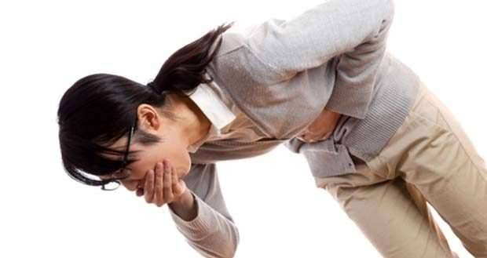
What Is Poisoning?
Poisoning is a lethal disruption of body’s physilogical machanism by the induction of an exogenic biological or chemical agent.

Slide 89
What Is Poison?
A poison is any substance that is harmful to your body.
Poisons may include-
Prescription or over-the-counter medicines taken in doses that are too high
Overdoses of illegal drugs
Carbon monoxide from gas appliances
Household products, such as laundry powder or furniture polish
Pesticides
Indoor or outdoor plants
Metals such as lead and mercury

Slide 90
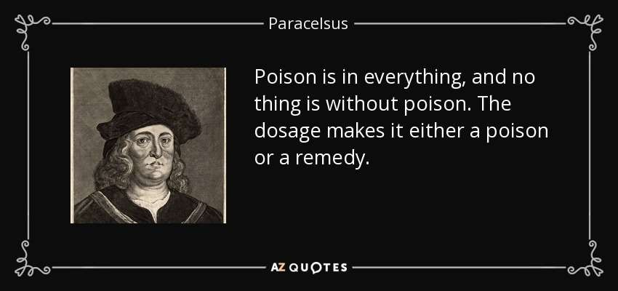
Reference source: https://www.google.com/search?q=paraselsus+poison&source=lnms&tbm=isch&sa=X&ved=0ahUKEwiSuLS YypfTAhUMLY8KHZnUDEMQ_AUICSgC&biw=1366&bih=659#imgrc=3AY7bp41zs22kM

Slide 91
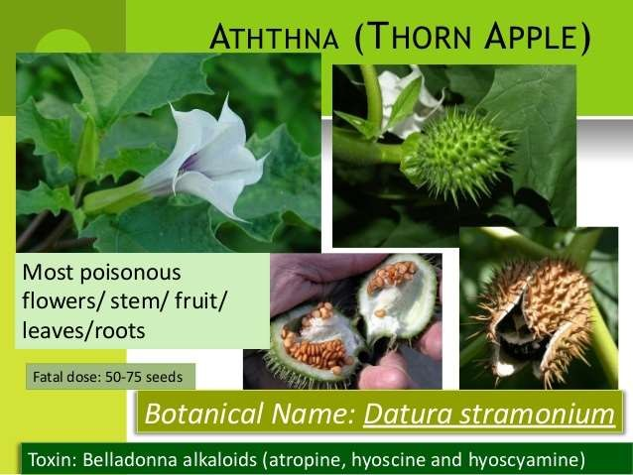
Medicinal Poisoning:
Medicinal poisoning, also called Drug Poisoning. It has harmful effects on health and this kind of poisoning might lead to serious health hazard or even death.
For example, Acetaminophen poisoning, Barbiturate poisoning.

Slide 92
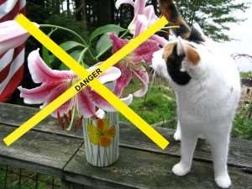
Animal and Plant Poisoning:

Slide 93

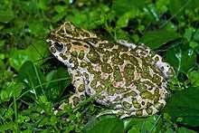
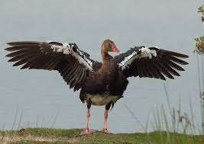
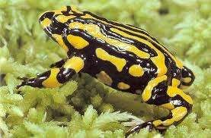
A List of Poisonous Animals:
Birds:
1. Blue-capped iffrit
Frogs and Toads:
1. European green toad
2. Spur-winged Goose:
2. Corroboree frog

Slide 94
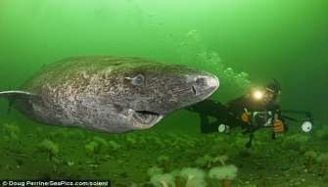
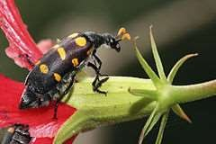
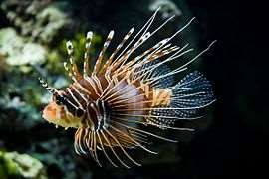
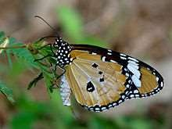
A List of Poisonous Animals:
Fish:
1. Greenland Shark
Insects:
1. Blister beetle
2. Lionfish
2. Milkweed butterfly

Slide 95

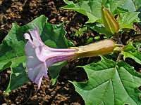


A List of Poisonous Plants:
1. Colchicum autumnale 3. Datura genus
2. Consolida subgenus
4. Erysimum cheiri

Slide 96
Factors Affecting Poisoning:
Form and innate chemical activity
Dosage, especially dose-time relationship
Exposure route
Species
Life stage, such as infant, young adult, or elderly adult
Gender
Ability to be absorbed

Slide 97
Continued……
⯈ Metabolism
⯈ Distribution within the body
⯈ Excretion
⯈ Health, including organ function, of the individual. Also, pregnancy involves physiological changes that could influence toxicity.
⯈ Nutritional status
⯈ Presence of other chemicals
⯈ Circadian rhythms (the time of day a drug or other substance is administered)

Slide 98
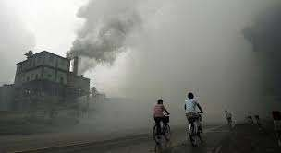
Environmental poisoning:
Environmental poisoning is a field of science that is concerned with the study of the harmful effects of various chemical, biological & physical agents on living organism.
Poison may include the following- CCl4, CHCl3, Benzene,
Toluene, Lead, Arsenic, Mercury etc.

Slide 99
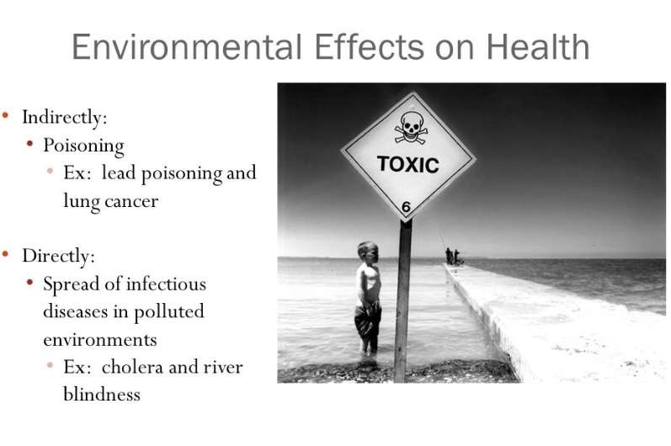
Reff: https://www.google.com/search?q=Environmental+poisoning&rlz=1C1CHBD_enBD774BD774&source=lnms&tbm=isch&sa=X &ved=0ahUKEwjpqIbN1PXXAhVCRY8KHadTDXgQ_AUICigB&biw=1350&bih=626#imgrc=jThC7PUKmu-hMM:

Slide 100
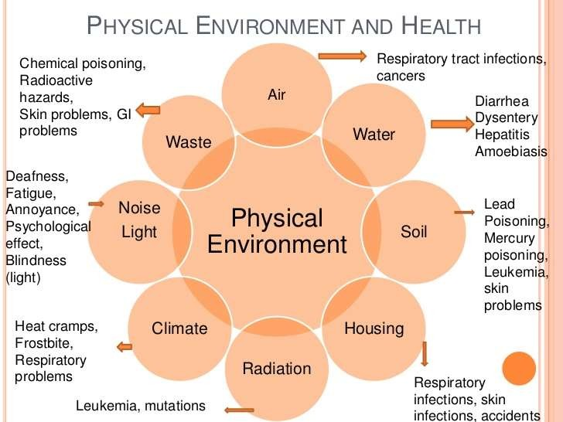
Reff: https://www.google.com/search?q=Environmental+poisoning&rlz=1C1CHBD_enBD774BD774&source=lnms&tbm=isch&sa=X &ved=0ahUKEwjpqIbN1PXXAhVCRY8KHadTDXgQ_AUICigB&biw=1350&bih=626#imgrc=bKhje8ziEH_STM:

Slide 101
FACTORS AFFECTING ENVIRONMENTAL POISONING:
Pesticides
DDT
Rodenticides
KBr
Heavy metals
Lead
Mercury
Cadmium
Gases & inhaled particles
Smoking
Halogenated hydrocarbons
Carbon tetrachloride
Chloroform
Aromatic hydrocarbons
Benzene
Toluene
Alcohols
Methanol
Propanolol

Slide 102
Halogenated hydrocarbon:
Properties:
Volatile Lipid soluble
Exposing route: inhalation or ingestion
Most will depresses CNS(Central Nervous System).
Carbon tetrachloride:
Source: Contaminated water.
Lower level inhalation produce irritation of eyes & respiratory Higher level produce nausea, vomiting, coma ,death from CNS
Chloroform:
Adverse effects are similar to carbon tetra chloride. It is hepatotoxic & nephrotoxic.
system. depression

Slide 103
Aromatic hydrocarbon:
Properties:
Volatile
Lipid soluble
Exposing route: inhalation or ingestion
Most will depresses CNS(Central Nervous System).
Benzene:
Source of Poisoning by Benzene:
Combustion of fossil fuels(gasoline) Contaminated water
Tobacco smoke.
Side Effects:
Hematopoietic toxicities, Leukemia, Agranulocytosis.

Slide 104
Alcohols:
Oxidization of alcohols can produce toxic products which result in coma, hypotension, seizures etc.
Eg: Methanol is oxidized to formic acid.
Pesticides:
Carbamate insecticides, rotenone & pyrethroids extends the time of sodium
channel opening .
Thus result in tremors, convulsions, burning & itching sensation.
Rodenticides:
Sometimes suicidal or accidental ingestion of rodenticides resulting in poisoning symptoms.

Slide 105
Gases & inhaled particles:
CO:
Colorless, odorless, tasteless gas.
Fireplaces, wood burning stoves, kerosene space heaters
are common source.
Symptoms of CO poisoning may include headache, lethargy, confusion, drowsiness, etc.
Cyanide:
Once absorbed into the body, it inactivate cytochrome oxidase
enzyme thus inhibit cellular respiration.
Death may occur from cyanide poisoning.
Sodium nitrite & sodium thiosulfate is used as antidote.

Slide 106
Asbestos:
Exposure of asbestos may causes asbestosis, mesothelioma & lung cancer.
Asbestosis is a chronic pulmonary disease with no specific
treatments.
Silica:
Mines, foundries & construction sites are sources of silica.
Exposure to silica causes to silicosis (ie. progressive lung
disease that result in fibrosis & emphysema).
Silicosis is currently incurable and the prognosis is often poor.

Slide 107
Barbiturate Poisoning:
20%-70% poisoning occur due to barbiturates. It occurs due to attempt to suicide.
Fatal dose: 10 times of clinical dose. Death comes from cardiovascular failure
Sign and symptoms of barbiturates poisoning:
CNS: Drowsiness, respiratory depression, coma.
CVS: Cardiovascular collapse, Hypotension , Dehydration, shock Lungs: Pulmonary oedema, Bronchopneumonia
Kidney: Cerebral depression, Renal failure Temperature: Hypothermia
Eye: Miosis (at first) Hypoxia (later)
Skin : lesion
Death from: respiratory depression

Slide 108
Treatment of Barbiturate Poisoning:
General measures:
Removal of unabsorbed drug by stomach wash
O2 inhalation
Universal antidote: activated charcoal
Specific antidote: inj. Amiphenazole
Specific measures:
Antibiotic to prevent pulmonary infection
Cardiotonic agent: inj. Dopamine to increase renal flow

Slide 109
Opoid Poisoning (Morphine):
Symptoms & signs of morphine poisoning:
Main Features:
Coma
Miosis
Extreme slowing of respiration
Secondary features
Low body temperature
Loss of skeletal muscle tone
Absence of reflexes
Cyanosis
Diagonostic feature
Respiratory depression
Miosis
coma

Slide 110
Management of Morphine Poisoning:
Stomach wash with worm water then with KMnO4. Gastric lavage
Administration of activated charcoal
Specific antidote:
Naloxane(0.4-0.8mg)
Naltroxone
Nalorphine
levallorphan
Keep the patient awake by repeated pinching
O2 inhalation
Coramine: For respiratory depression. 1000mi of 5% glucose i/v

Slide 111
Acetaminophen Poisoning:
Acetaminophen is an effective analgesic and anti-pyretic.
Dose of paracetamol:
Daily dose: 500mg, 1-2 tab, 4-6 hourly Max dose: 4gm daily
Normal dose: 1-4gm/day Toxic dose : >150mg/kg Fatal dose: >250mg/kg
Toxicities of paracetamol:
Early toxicities
Nausea
Vomiting Anorexia Abdominal pain

Slide 112
Continued…
Delayed toxicities: Hepatic necrosis Hypoglycaemic coma Pancytopenia Leucopenia
Skin rash
Management of acute overdose of paracetamol:
Gastric lavage
Antidote: acetylcysteine (iv) I/V steroid and antihistamines
Monitoring of the therapy and liver damage

Slide 113
Antidepressant Poisoning:
Acute toxicities of TCA: CNS: Excitement Convulsion coma
Heart:
Cardiac arrythmia, hypotension
Treatment of acute TCA toxicities:
Activated charcoal Gastric lavage Physostigmine
Anti arrythmic drug
Anti convulsant: Diazepam.

Slide 114


Slide 115

POISONING – THE PHARMACIST’S ROLE IN PREVENTING:
Apply expert knowledge of pharmacology & medication use behaviors
Conduct education
Perform epidemiologic surveillance
Support disaster planning
Manage antidote inventory & usage
Participate in clinical toxicology
services
Run a drug & poisons information centre

Slide 116
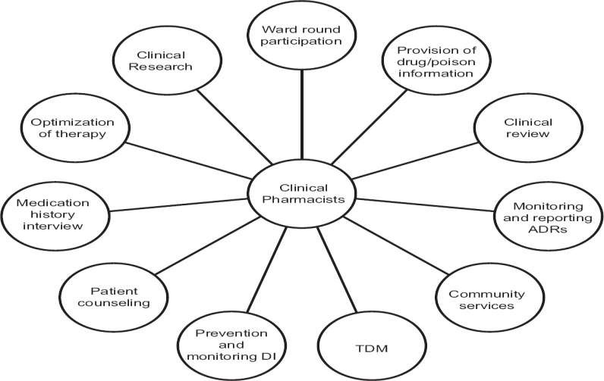
The Role of Clinical Pharmacist to Prevent Poisoning:
Reff: http://www.jpbsonline.org/articles/2015/7/3/images/JPharmBioallSci_2015_7_3_161_160005_u7.jpg

Slide 117
Diagnosis:
Consideration of poisoning in patients with altered consciousness or unexplained symptoms:
Assess the overall status of the patient.
Severe poisoning may require rapid intervention to treat airway compromise or cardiopulmonary collapse.
History from all available sources:
History is often the most valuable tool. Because many patients (eg, preverbal children, suicidal or psychotic adults, patients with altered consciousness) cannot provide reliable information, friends, relatives, and rescue personnel should be questioned.
Selective, directed testing:
Physical examination sometimes detects signs suggesting particular types of substances

Slide 118
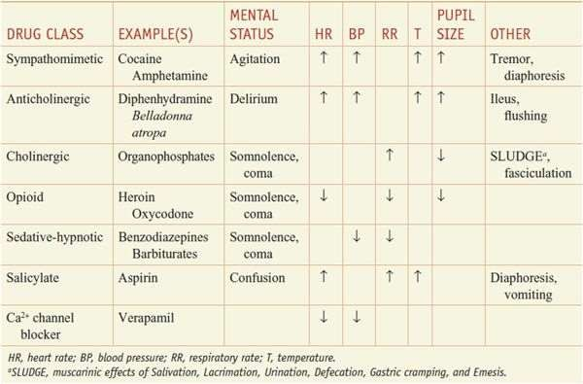
Ref source: https://www.google.com/search?q=toxidroms+goodman+gillman&source=lnms&tbm=isch&sa=X&ved=0ahUK EwjYif_wu5rTAhVFpY8KHfZZDPwQ_AUICSgC&biw=1366&bih=659#imgrc=ba_cXQN-HfOufM

Slide 119
BASIC PRINCIPLES OF POISONING TREATMENT:
⯈ Initial stabilization
⯈ Topical decontamination
⯈ Activated charcoal
⯈ Gastric emptying
⯈ Whole-bowel irrigation
⯈ Alkaline diuresis
⯈ Dialysis
⯈ Specific antidotes
⯈ Ongoing supportive measures

Slide 120
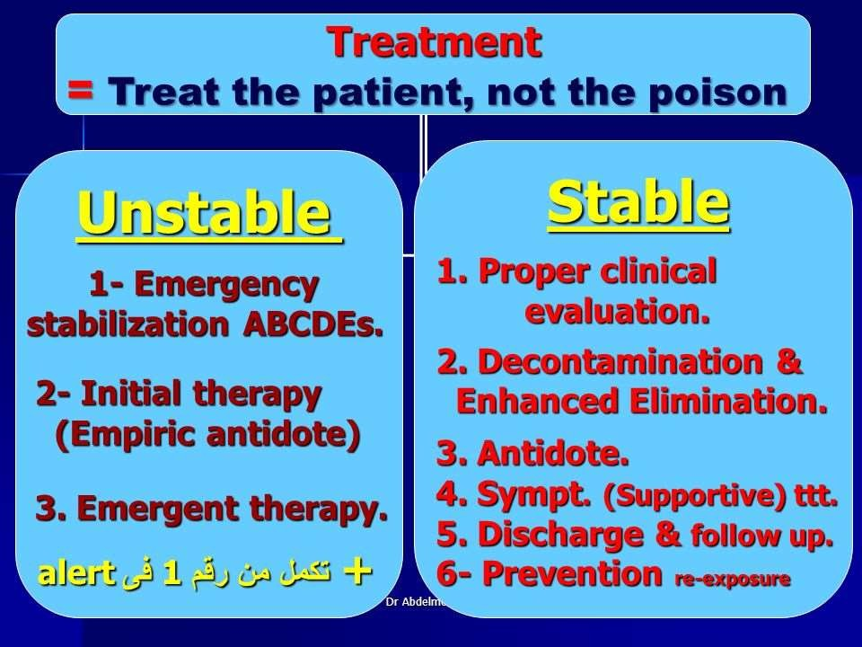

Slide 121
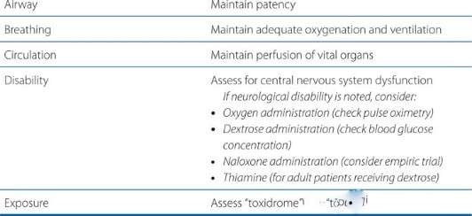

INITIAL TREATMENT OPTION FOR ACUTE POISONING: ABCDE
Reff: https://www.google.com/search?q=differential+poisoning+diagnosis+goodman&source=lnms&tbm=isch&sa=X&ved=0ahUKEwitxsix2 ZrTAhUXT48KHe0wD68Q_AUIBigB&biw=1366&bih=659#tbm=isch&q=initial+treatment+aoroach+for+acute+poisoning+goodman& imgrc=ZWXm9CIs-vlaRM:

Slide 122
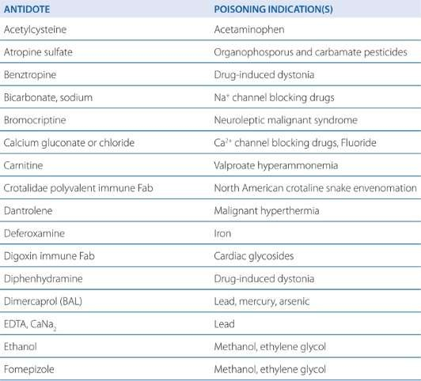
Specific antidotes
Reff:https://www.google.com/search?q=some+common+antidotes+and+their+indication+goodman+gilman&source=lnms&t bm=isch&sa=X&ved=0ahUKEwjkis2pwprTAhUCS48KHVfyB5QQ_AUICCgB&biw=1366&bih=659#imgrc=DIjg9T3ETkOe-M:

Slide 123
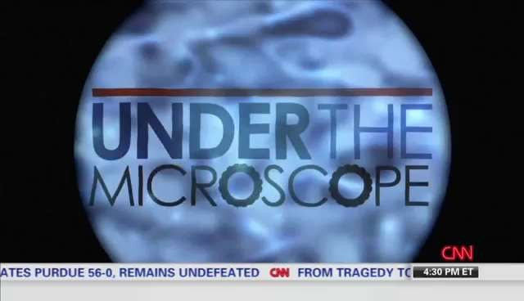

Slide 124
References:
Goodman & Gillman’s The Pharmacological Basis of Therapeutics, 12th edition, Chapter 4
Lippincott Illustrated Reviews: Pharmacology 6th edition, Chapter 43
http://www.merckmanuals.com/professional/injuries- poisoning/poisoning/general-principles-of-poisoning
www.Wikipedia.com

Slide 125
Snake Bite Management –Neglected Occupational Diseases
By Dr. Ashok Laddha
•
•
Emergency Medicine Occupational health physician

Slide 126
Background
Snakebite is an occupational hazard causing considerable morbidity and mortality worldwide, particularly so in tropical countries like India.
An estimated 50,000 Indians die due to venomous snakebite every year, seventy percent of whom are males between the ages of 20 to 50 years. Along with the associated morbidity and mortality, snakebite leads to a significant financial burden on the victim, both by way of hospital bills and labour hours lost.
Snakebite is also a cause for considerable psychological stress
among survivors.
Most snakebites are eminently treatable and curable. Given a concerted thrust from all concerned , this menace could surely be curtailed considerably over the next few years.

Slide 127
Facts-1
“Snakebite is an accident, not a misfortune
“The large number of snakebite death cases per annum in India occurs due to three main reasons: lack of adequate medical infrastructure, strong belief in myths, and lack of trained doctors,,
“biggest man-animal conflict”.
In June 2017, the World Health Organization added snakebite to the list of neglected tropical diseases’.
Occupational Disease for Agricultural worker

Slide 128
Facts-2
10 percent of the total snake species found in the world are poisonous
80% of them are non-poisonous.
The venomous snakes include only about 58 species and
There are only 4 species of snakes that are dangerous to man, namely, Cobra, Krait, Russell's viper and Saw-scaled viper.
India has been recognized as having the highest snakebite mortality in the world. Most of the fatalities, are due to victims not reaching the hospital in time, and are preventable.

Slide 129
Facts-3
Almost 300 species are existing in India
5 0 Species are poisonous
10 deadliest snakes in India-
Russell's Viper,
Indian Krait,
Saw-Scaled Viper,
Spectacled Cobra,
King Cobra,
Hump-Nosed Pit Viper,
Malabar Pit Viper,
Bamboo Pit Viper,
Indian Rock Python
Yellow-Lipped Sea Krait

Slide 130
Classification of Snakes
1. Elapidae : Neurotoxic
2. Viperidae : Vasculotoxic
3. Hydrophidae : Myotoxic

Slide 131
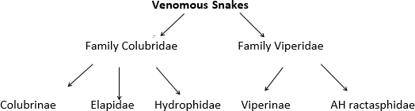
Classification of venomous snake

Slide 132
Identification of Poisonous and Nonpoisonous Snake
Belly:
Small scales not extending whole breadth= non poisonous
Large scales whole belly breadth= poisonous
Head:
Small scales = poisonous
Large scales = non poisonous
Side of Head:
Pit between eyes and nostrils = poisonous
3rd labial touches eyes and nasal shield = poisonous

Slide 133
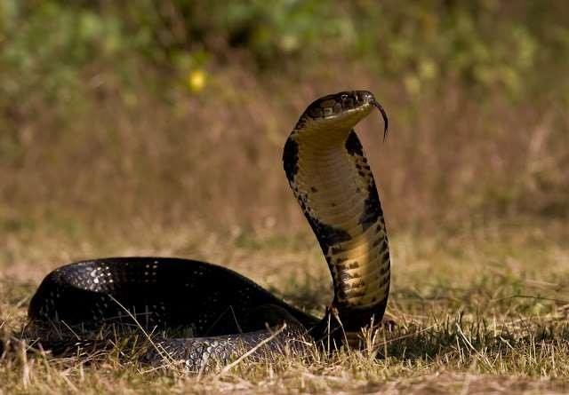
King Cobra

Slide 134
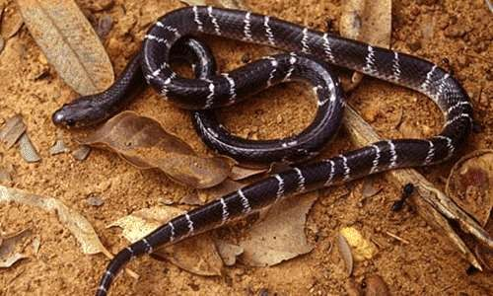
Indian Krait

Slide 135
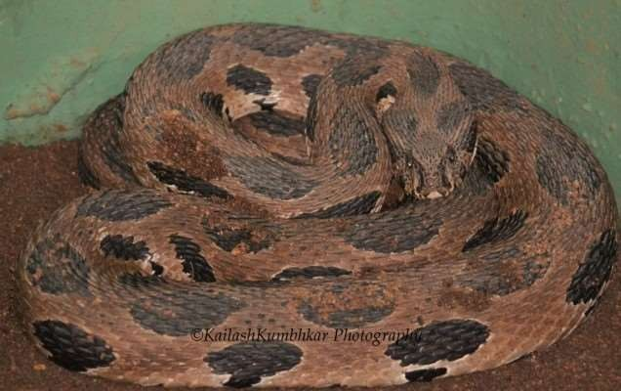
Russell Viper-Daboia

Slide 136
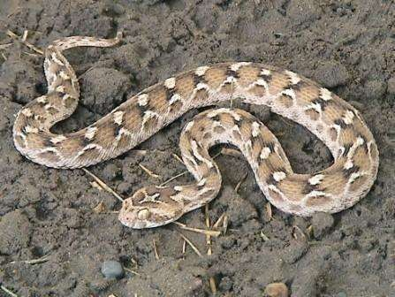
Saw-Scaled Viper

Slide 137
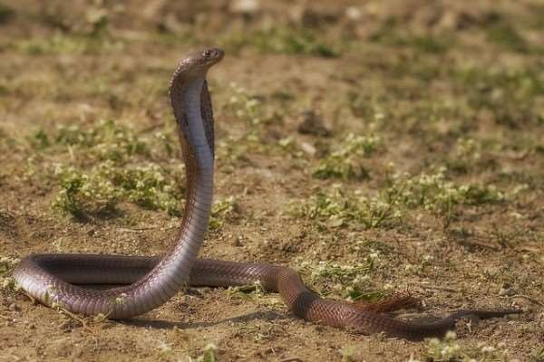
Indian Cobra-Naja Naja-Nag

Slide 138
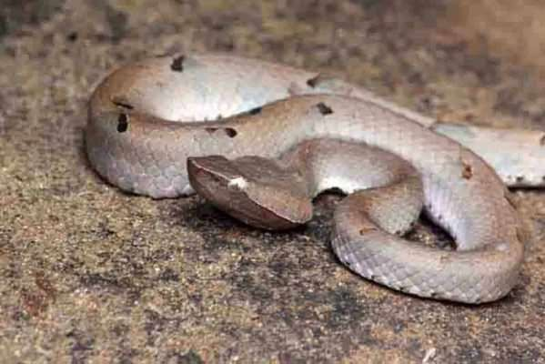
Hump Pit Viper

Slide 139
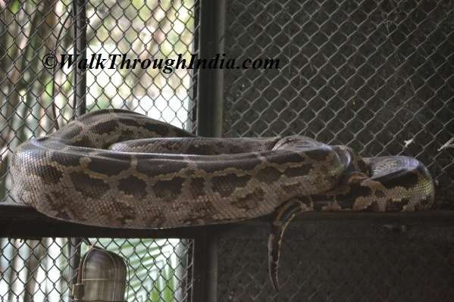
Rock Python

Slide 140
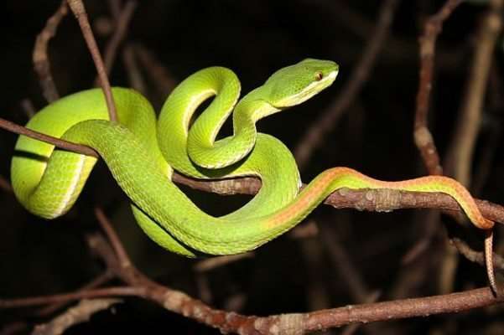
Bamboo Pit Viper

Slide 141
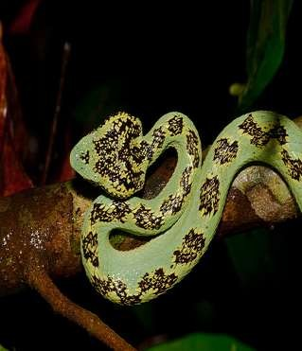
Malabar pit viper

Slide 142
Types of Snake venom
A)-Cardio-toxic---due to direct toxic effect of venom
B)-Hemato-toxic- effect on Blood and blood vessels
Nephro toxic------
1)due to direct toxic effect of venom
2)Enzymatic activities of snake venoms account for
direct nephrotoxicity.
3)Immunologic
C)-Myo-toxic-has localized effect at bite site
D)-Hemorrhagic Envenoming
E)-Neuro toxic-there are many types with differing actions, but the most common cause flaccid paralysis of skeletal muscle by blocking transmission at the neuromuscular junction, either presynaptically or post-synaptically;

Slide 143
Compounds present in snake venom
Enzymes----Phospholipase A₂ (lecithinase), 5^{¢-nucleotidase}, collagenase, L- amino acid oxidase, proteinases,hyaluronidase, acetylcholine esterase*, phospholipase B*, endopeptidase†, kininogenase†, Factor X†, prothrombin activating enzyme†
bungarotoxin, crotoxin, and taipoxin) cardiotoxin, crotamine
Peptides----pyroglutamylpeptide
Nucleosides----Adenosine, guanosine, inosine
Lipids----Phospholipids, cholesterol
Amines----Histamine, serotonin, spermin
Metals-----Copper, zinc, sodium, magnesium
Nonenzyme | polypeptides----1)Polysynaptic (a) | neurotoxin | (α-
bungarotoxin | and cobrotoxin), 2)presynaptic (b) | neurotoxin | (β-

Slide 144
Toxic effect of snake venom-1
The toxic effect of snake venom results from both the protein and the nonprotein component. It is further complicated by the inflammatory response of the victim's body.
Phospholipase A2 is present in the venom of all families of poisonous snakes and is the enzyme that has been most widely studied. Phospholipase A2 inhibits electron transfer at cytochrome C level and renders mitochondrial-bound enzymes soluble. It damages red blood cells, leukocytes, platelets, skeletal muscle, vascular endothelium, peripheral nerve endings, and the myoneural junction.

Slide 145
Toxic effect of snake venom-2
Hyaluronidase helps spread of venom through tissues, and proteolytic enzymes are responsible for the local edema, blistering, and necrosis.
α- Neurotoxins bind to acetylcholine receptors at the motor end-plate, whereas β- neurotoxins first cause release of acetylcholine at the nerve endings at the myoneural junction and then damage the endings, preventing further release of transmitter. All this leads to a flaccid paralysis of the victim.
Polypeptides, being smaller molecules, are rapidly absorbed into the systemic circulation and cause systemic toxicity in vessel-rich organs (e.g., heart, lung, kidneys, etc.) as well as at pre- and postsynaptic membranes.

Slide 146
Classification-Toxic components of snake venom
Enzymes,
Polypeptides,
Glycoprotein's, and
Compounds of low molecular weight.
They can also be classified as protein (90–95%) and non-protein (5–10%) compounds

Slide 147
Various snakebites, their fatal dose, quantity of venom injected, and time to fatality
Snake | Fatal dose in human | Average dose delivered per bite | Average Fatal Period
Indian cobra | 12 mg | 60 mg | 8 hrs
Common Krait | 6 mg | 20 mg | 18 hrs
Russell's viper | 15 mg | 63 mg | 4 days
Saw scaled viper | 8 mg | 13-40 mg | 41 days

Slide 148
Snake bite
Causes of Morbidity and Mortality

Slide 149
Medical reasons
Lack of awareness among victims about medical facility
Alternate forms of treatment practiced in villages wherein the victim is first taken to a faith healer (quack), precious time being lost therein
Improper first aid measures immediately after the bite which increases the chances of systemic envenomation and additional complications
unavailability of the standard treatment, anti-snake venom (ASV) in rural centers,
• r e l u c t a n c e o n t h e p a r t o f t h e p r i m a r y c a r e t a k e r a t the village centre to admit and treat snakebites fearing complications and reactions to

Slide 150
Socio-Cultural Factors
The fact that most village dwellers do not use protective foot wear (70% of bites are on the lower limbs)
habit of sleeping on the floor/ ground
presence of livestock near the house which in turn attracts rats
defecating in open fields, often after dark
Increasing Alcoholism

Slide 151
Legislative / Governmental
High cost of horse serum based ASV
Absence of a centralized quality control on the process o f manufacture of ASV as also its standardizationt
Delay in initiation of ASV treatment due to non- availability of kits for the early diagnosis of venomous snakebite
Aabsence of regional or zonal pools of snake venom

Slide 152
Socio economic Factor
Ever increasing population leading to greater encroachment thereby increasing the chances of human reptile contact and bites
Inadequate infrastructure in villages, including lighting, sewerage systems, roads, in house water supply etc
Improper sanitation
poor transport facilities-delay in shifting victim to secondary or tertiary set up

Slide 153
Complications of snake bite-1
Cardiac
T wave changes/ST depression/OT prolongation
Myocardial Infraction—due to vasospasm or coronary artery thrombosis
Cardiac Rhythm disturbance
AV block
Pulmonary edema
Hypotension

Slide 154
Complications of snake bite-2
Neurological complications---
Stroke
Paralysis
Ptosis
Ophthalmoplegia
Respiratory Failure
Convulsions
Delayed sensory neuropathy
Locked in syndrome

Slide 155
Renal complications
Acute renal failure
Oliguria
Haematuria
Albuminuria,
Prolonged bleeding time,
Prolonged prothrombin time,
Low hemoglobin and a high total bilirubin

Slide 156
Snake bite Comlications-3
Hematoxic ------------
Affects blood clotting
some venoms posses anticoagulant activity, and promote excessive bleeding (cerebral haemorrhages can be very fatal – 20% of people who die after a snake bite have cerebral hemorrhages'),
while other toxins are procoagulant – initially causing wide spread clot formation, followed by defibrinogenation, making patients more vulnerable to strokes
ARDS
Haemorrhagic pericardial effusion

Slide 157
Local complications
Pain
Swelling
Vision damage /corneal ulceration due to spray
Compartment syndrome
Necrosis
Gangrene
Infection
Limb loss
Chronic ulceration

Slide 158
Types of anti snake venom
Mono-valent/Monospecific-Species specific
Polyvalent-effective against several species
Note: As per the recommendations of WHO, the most effective treatment for snakebite is the administration of monospecific ASV however, this therapy is not always available to snakebite victims because of its high cost, frequent lack of availability, and the difficulty in correctly identifying the snake.

Slide 159
What is snake venom?
Snake antivenom, also known as snake venom antiserum and antivenom immunoglobulin is a medication made up of antibodies used to treat snake bites by venomous snakes. It is a type of antivenom.
It is a biological product that typically consists of venom neutralizing antibodies derived from a host animal, such as a horse or sheep. The host animal is hyperimmunized to one or more snake venoms, a process which creates an immunological response that produces large numbers of neutralizing antibodies against various components (toxins) of the venom. The antibodies are then collected from the host animal, and further processed into snake antivenom for the treatment of envenomation.
They are on the WHO LIST of essential medicines, the most important medications needed in a basic health system

Slide 160
Importance of Anti snake venom
Snake antivenom immunoglobulins are the only specific treatment for envenoming by snakebites
Antivenom therapy is key to the medical management of snakebite
Antisera is essential because:
No alternative successful therapy.
High degree of mortality and morbidity in the absence of treatment.
The diseases in which they are used represent a heavy toll of human suffering.
Largely affects children and farmers in rural communities.
Unfortunately there are a number of problems for developing countries in accessing and using antivenoms – WHO.
.

Slide 161
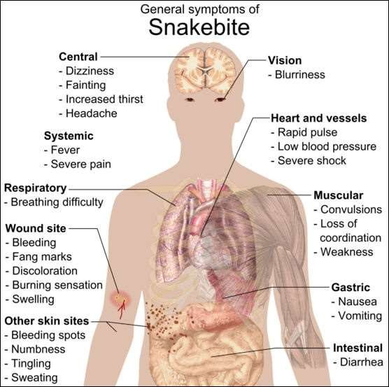
General Symptoms of Snake Bite

Slide 162
Local features in snake bite-1
Fang marks: Generally, the presence of two puncture wounds indicates a bite by a poisonous snake. In the case of a non-venomous snakebite, small puncture wounds are seen arranged in an arc.
Pain : Burning, bursting or throbbing pain may develop immediately after the bite and spread proximally up the bitten limb. Draining lymph nodes soon become painful. Krait and sea snake bites maybe virtually painless

Slide 163
Local features in snake bite-2
Local swelling : Viper bites produce more intense local reaction than other snakes. Swelling may become apparent within 15 minutes and becomes massive in 2-3 days. It may persist for up to 3 weeks. The swelling spreads rapidly from the site of the bite and may involve the whole limb and adjacent trunk. Regional lymphadenopathy may develop. In case the envenomed tissue is contained in a tight fascial compartment like the pulp space of digits or anterior tibial compartment, ischaemia will develop. If there is no swelling 2 hours after a viper bite, it is safe to assume that there has been no envenoming

Slide 164
Snake bite treatment protocol
First aid
Pre hospital and hospital Emergency Management—ABC
Diagnosis Phase
Treatment Phase

Slide 165
First aid
Present first aid protocol is ineffective and dangerous
Traditional methods to be avoided
Modified Method of first aid------
Reassurance
Immobilization
Rush to hospital immediately
Avoid use of tourniquet

Slide 166
Diagnostic Features
Swelling, blistering or necrosis at the site of the bite and its extension
Hypotension / shock
Haemorrhage
Laboratory evidence of coagulation defect
Neuroparalytic manifestations
Arrhythmias / bradycardia / tachycardia
Myoglobinuria

Slide 167
20 WBCT
Twenty-minute whole blood clotting test (20WBCT) is considered as reliable test of coagulation which can be carried out by bedside and is considered to be superior to ‘capillary tube’ method for establishing clotting capability in snake bite. A few milliliters of fresh venous blood should be placed in a fresh, clean and dry glass vessel preferably test tube and left undisturbed at ambient temperature for 20 minutes. After that tube should be gently tilted to detect whether blood is still liquid and if so then blood is incoagulable. The test should be carried out every 30 minutes from admission for 3 hours and then hourly after that.

Slide 168
Investigations
Hb
platelet count
peripheral smear
prothrombin time (PT)
activated partial thromboplastin time (APTT)
fibrin degradation products (FDP)
D-Dimer
Urine examination for proteinuria/RBC/hemoglobinuria/ Myoglobinuria
Biochemistry for serum creatinine/Urea/Potassium
ECG/X-ray/CT/Ultrasound (The use of X-ray and ultrasound are of
unproven benefit, apart from identification of clot in viperine bite)
Oxygen saturation/arterial blood gas (ABG)
Enzyme-linked immunosorbent assay (ELISA) to confirm snake

Slide 169
Assessment of severity of envenomation
No envenomation | Absence of local or systemic reactions; fang marks (+/−)
Mild envenomation | Fang marks (+), moderate pain, minimal local edema (0–15 ce), erythema (+), ecchymosis (+/−), no systemic reactions
Moderate envenomation | Fang marks (+), severe pain, moderate local edema (15–30 cm), erythema and ecchymosis (+), systemic weakness, sweating, syncope, nausea, vomiting, anemia, or thrombocytopenia
Severe envenomation | Fang marks (+), severe pain, severe local edema (>30 cm), erythema and ecchymosis (+), hypotension, paresthesia, coma, pulmonary edema, respiratory failure

Slide 170
Indication for ASV-1
Hemogram: The hemogram may show transient elevation of hemoglobin level due to hemoconcentration (because of the increased capillary leak) or may show anemia (due to hemolysis, especially in viper bites).
Presence of neutrophilic leucocytosis signifies systemic absorption of venom.
Thrombocytopenia may be a feature of viper envenomation.
Serum creatinine: This is necessary to rule out renal failure after viper and sea snake bite.
Serum amylase and creatinine phosphokinase (CPK): Elevated levels of these markers suggests muscle damage (caution for renal damage).
Prothrombin time (PT) and activated partial thromboplastin time (aPTT): Prolongation may be present in viper bite

Slide 171
Indication for ASV-2
Fibrinogen and fibrin degradation products (FDPs): Low fibrinogen with elevated FDP is present when venom interferes with the clotting mechanism.
Arterial blood gas and electrolyte determinations: These test are
necessary for patients with systemic symptoms.
Urine examination: Can reveal hematuria, proteinuria, hemoglobinuria, or myoglobinuria. (Arterial blood gases and urine examination should be repeated at frequent intervals during the acute phase to assess progressive systemic toxicity).
Electrocardiogram (ECG): Nonspecific ECG changes such as bradycardia and atrioventricular block with ST-T changes may be seen.

Slide 172
Indication of ASV-3
Electroencephalogram (EEG): changes have been noted in
Recently, EEG
up to 96% of
patients bitten by snakes. These changes start within hours of the bite but are not associated with any features of encephalopathy.
These abnormal EEG patterns were seen mainly in the temporal lobes.
Whole blood clotting time >20 min

Slide 173
Indication for Anti snake venom
Evidence of systemic toxicity------
1-Heamodynamic instability
2-Respiratory instability
3-Hypotension
4-Neurological complications
5-Clinically significant bleeding
6-Abnormal coagulation studies
7-Progressive soft tissue swelling
8-Passage of dark brown urine
9-Snake identified as venomous

Slide 174
ASV Administration
ASV can be administered either by slow intravenous injection at a rate of 2 ml/min or by intravenous infusion (antivenom diluted in 5–10 ml per kilogram body weight of normal saline or D₅ W and infused over 1 h). Slow intravenous injection has the advantage that a doctor or nurse is present during the injection period when there is a risk of some early reaction to the ASV. All patients should be strictly observed for an hour for development of any anaphylactic reaction. Epinephrine should always be kept ready before administration of antivenom.

Slide 175
ASV Reaction
Immediate within 15 mins
Delayed –Serum sickness

Slide 176
Delayed Reaction
Develop 1–12 (mean 7) days after treatment. Clinical features include fever, nausea, vomiting, diarrhea, itching, recurrent urticaria, arthralgia, myalgia, lymphadenopathy, immune complex nephritis and, rarely, encephalopathy.

Slide 177
Pyrogenic Reaction
Generally develop 1–2 h after treatment. Symptoms include chills and rigors, fever, and hypotension. These reactions are caused by contamination of the ASV with pyrogens during the manufacturing process.

Slide 178
Immediate Reaction
Early Anaphyalctic reaction occurs within 10– 180 min of start of therapy and is characterized by itching, urticaria, dry cough, nausea and
vomiting, abdominal colic, tachycardia, and fever. Some
diarrhea,
patients
may
develop severe life-threatening
anaphylaxis
characterized by hypotension, bronchospasm, and angioedema.

Slide 179
Treatment for ASV Reaction
1-When the patient shows signs of a reaction, antivenom administration must be temporarily stopped and adrenaline (1 in 1000) given intramuscularly in an initial dose of 0.5 mg in adults or
0.01 mg/kg body weight in children. The dose can be repeated every 5–10 min if necessary.
After adrenaline, an anti-H1 antihistamine such as chlorpheniramine maleate (adult dose 10 mg, children 0.2 mg/kg) should be given intravenously. It may be followed by intravenous hydrocortisone (adult dose 100 mg, children 2 mg/kg).
Late (serum sickness–type) reactions usually respond to a 5-day course of oral antihistamine (e.g., chlorpheniramine 2 mg six hourly in adults and 0.25 mg/kg/day in divided doses in children). Patients who fail to respond within 24–48 h should be given a 5-day course of prednisolone (5 mg six hourly in adults and 0.7 mg/kg/day in divided doses in children).

Slide 180
ASV Dose Requirement
1 ASV vial neutralizes the 6 mg of snake venom
Note:
Each ml of Antisnake venom antiserum neutralizes not less than the following quantities of standard venoms Cobra 0.60 mg, Common Krait 0.45 mg, Russell’s Viper 0.60 mg, Saw- Scaled Viper 0.45 mg.

Slide 181
TOURNIQUETS - TOURNIQUET USE IS CONTRAINDICATED IN INDIA
Risk of ischemia
Loss of limb
Increased Risk of Necrosis with 4/5 of the medically significant snakes of India.
Increased risk of massive neurotoxic blockade when
tourniquet is released.
Risk of embolism if used in viper bites.
Pro-coagulant enzymes will cause clotting in distal blood.
In addition, the effect of the venom in causing vasodilatation presents the danger of massive hypotension and neuroparalysis when the tourniquet is released
They give patients a false sense of security, which encourages them to delay their journey to hospital.

Slide 182
Pre hospital emergency Management
Immobilization
Keep immobilised part below the heart level
Manage air way /Breathing /Circulation
CPR
Immediately transfer the victim to nearest hospital

Slide 183
Hospital Management
Local
Specific
Supportive

Slide 184
Local signs
fang marks
local pain
local bleeding
bruising
Lymphangitis
lymph node enlargement
inflammation (swelling, redness, heat)
Blistering
local infection, abscess formation
necrosis

Slide 185
Hospital emergency management
Assess ABC
Assess state of level of consciousness
CPR if required
Oxygen
Large bore IV Canula
Iv Fluids
Specific Treatment after History and physical examination
Pain Management –Paracetamol/Tramadol
Specific treatment as per complication
Surgical intervention

Slide 186
Principle of ASV Therapy
I vial of ASV Neutralizes the 6 mg of Snake venom –the dose of 8-10 vials is absolutely necessary to neutralize average venom injected per bite.
Total range of venom injected by all species is 5mg-147mg---25 vials
ASV dose is same in children and adult

Slide 187
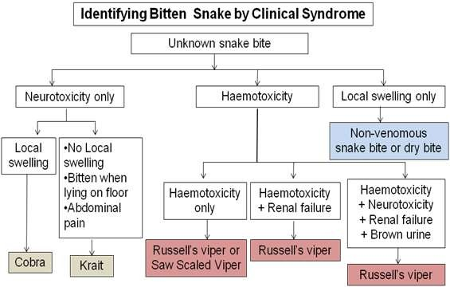
Identification of Snake bite

Slide 188
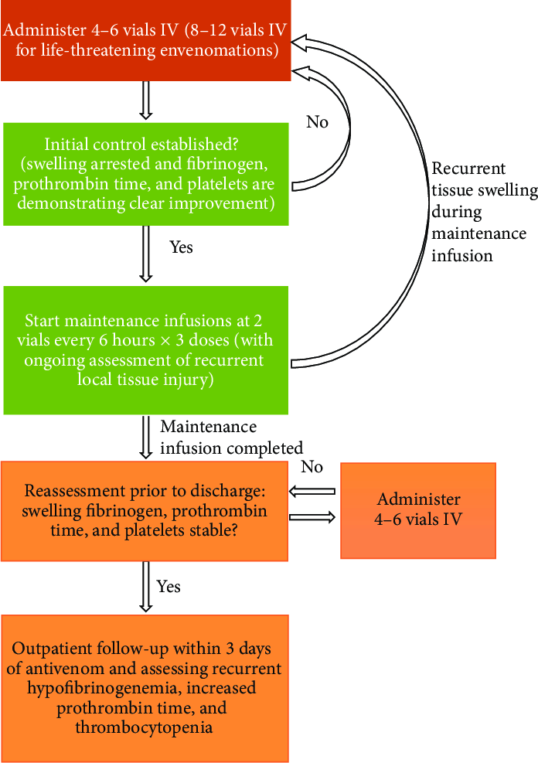
Flow chart --Treatment Protocol

Slide 189
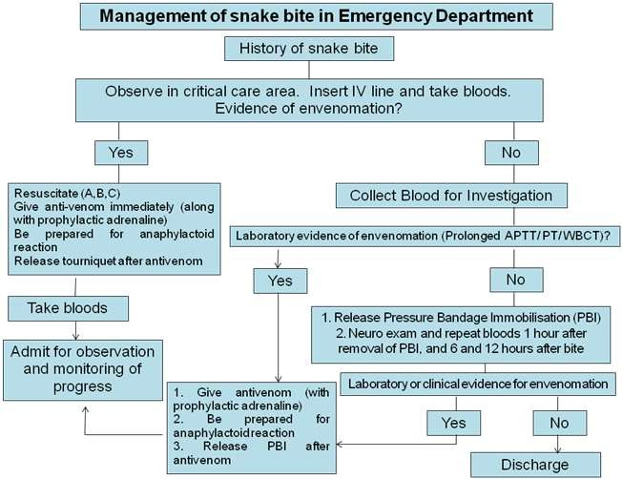
Snake bite management-Flow chart

Slide 190
Supportive Treatment
Fresh frozen plasma
Cryoprecipitate (fibrinogen, Factor VIII), Fresh whole blood,
Platelet concentrate. Broad spectrum antibiotics
Prophylaxis against tetanus and gangrene Surgical debridement if required/Mechanical Ventilation/Dialysis

Slide 191
Role of Neo-stigmine and Atropine
If Neurotoxic: Neostigmine is an anticholinesterase, which is particularly effective in postsynaptic neurotoxins such as those of cobra and is not useful against presynaptic neurotoxin i.e. common Krait and the Russell’s viper. Neostigmine test should be performed by administering 0.5–2 mg IV and if neurological improvement occurs, it should be continued 1/2 hourly over next 8 hours.
Measure Single breath count 1.5 mg Neostigmine given IM, 0.6mg atropine given IV Repeat Single breath count every 10 minutes for 1 hour If improves give 0.5mg neostigmine every 30 minutes until recovery, if no improvement discontinue neostigmine. Monitor patient for 1-2 hours, if symptoms do not improve or worsen i.e. paralysis descends repeat dose of 4 vials of ASV. Maximum 12 vials. If patient unable to perform supine neck lift prepare for respiratory support with mechanical ventilation or resuscitation bag with improvised nasopharyngeal tubes by cutting size 5 endotracheal tubes to length of nostril to tragus, lubricate and insert.

Slide 192
Signs of Recovery
Spontaneous systemic bleeding such as gum bleeding, bleeding from venepuncture sites etc.usually stops within 15 to 30 minutes. Blood
coagulability is usually restored in 6 hours.
Post-synaptic neurotoxic envenoming such as the Cobra may
begin to improve as early as 30 minutes after ASV.
Pre-synaptic neurotoxic envenoming such as the krait usually takes a considerable time to improve.
Active hemolysis and Rhabdomyolysis may cease within few hours and urine return to its normal colour.
In patient with shock, blood pressure may increase after 30
minutes.
•

Slide 193
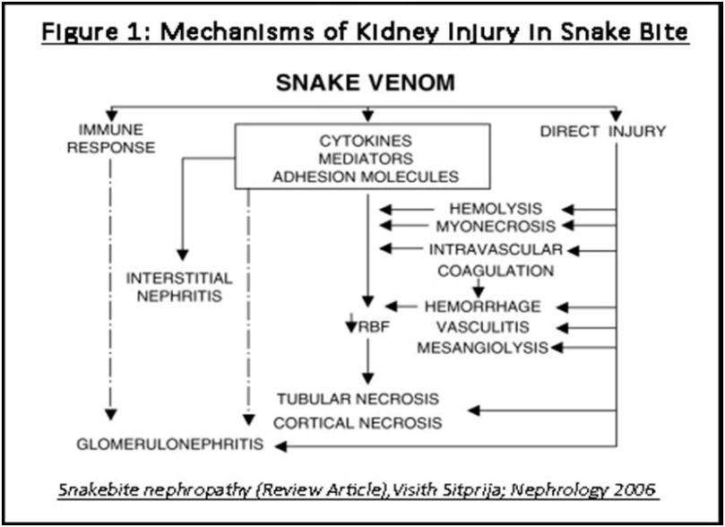
Mechanism of kidney injury in snake bite

Slide 194
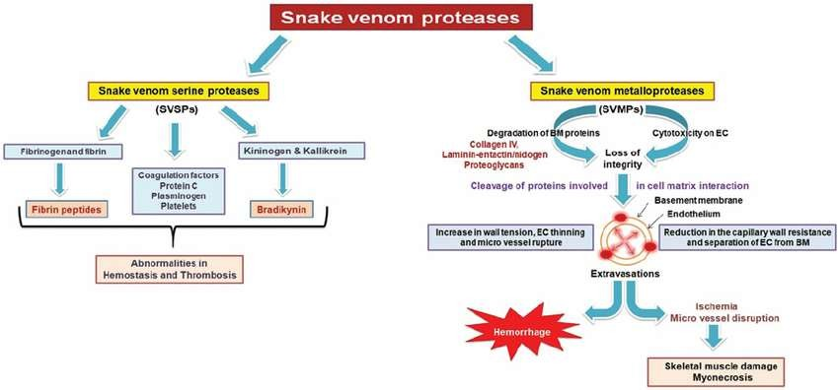
Mechanism of action snake venom

Slide 195
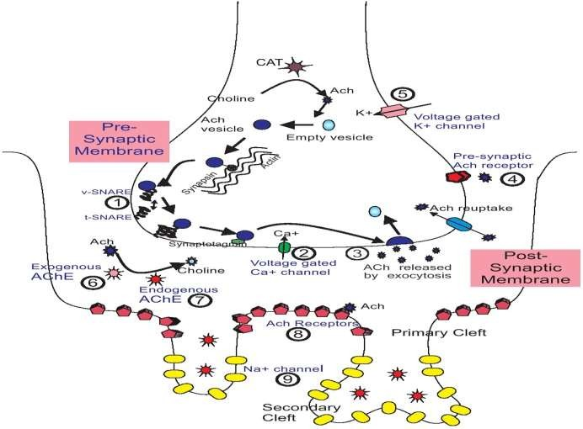
Sites of action of snake neurotoxins and other substances on the neuromuscular junction

Slide 196

Surgical intervention

Slide 197
Referral Criteria
systemic bleeding
Acute renal failure
Neurotoxic snake bite requiring mechnaical ventilation for long period
Surgical cases requiring debridement of necrotic tissue

Slide 198
Poor Prognostic Indicators
Low Platelets < 20,000/mm3
Polymorphonuclear
leucolytosis with presence of band form
Crenated RBC
Raised D - Dimer,
low fibrinogen,
Low serum protein and albumin,
haemoglobinuria, bilateral parotid swelling
"Viper Head" appearance,
Giddiness, syncoPe
immediately following a snake bite,
agitated
behavior - cerebral anoxia, profound thirst
•

Slide 199
Post discharge planning
Instruct patient for hospital visit for
Worsening of swelling even after elevation
Abnormal bleeding(Gums,Malena etc)
Information to be given regarding serum sickness
Bleeding precaution at least for 2 weeks
Regular check up of blood indices

Slide 200

Identification of snake bite

Slide 201

Tissue Necrosis

Slide 202
Lastly--------------
Snake looks scary for us and we look scary for snakes
It is innocent animal having large number of enemies
Prevention is best but antivenin treatment must also be improved
We need lot OF research to develop monospecific ASV

